Slide 1

Predictive Modelling for Weekly Sales: A Method of Moments and Bayesian Regression Approach
DATA SCIENCE FINAL PROJECT

Slide 2



CURATORS
THE TEAM
Sanika Dhayabar Patil
Suyesha Lamne
Akanksha Pandey

Slide 3
The Purpose
The primary objective is to predict weekly sales for a given location based on two key independent variables: temperature and fuel price.
By understanding the relationship between these variables and sales, the project aims to create a predictive model that can estimate sales for future weeks.

Slide 4
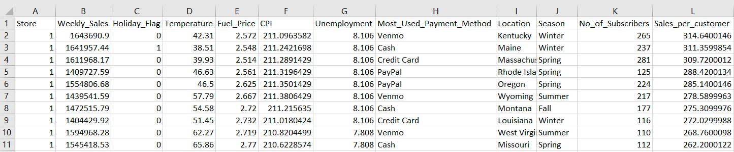
DataSet : Walmart Weekly Sales

Slide 5
MOM
Bayesian Regression
The Method of Moments (MoM) is a statistical technique used to estimate the parameters of a probability distribution or a statistical model.
It is a statistical approach to regression analysis that applies the principles of Bayesian statistics to model relationships between variables.

Slide 6
01
MOM

Slide 7
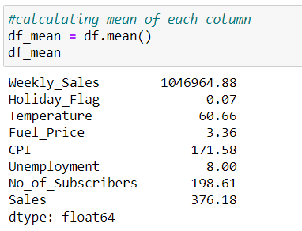
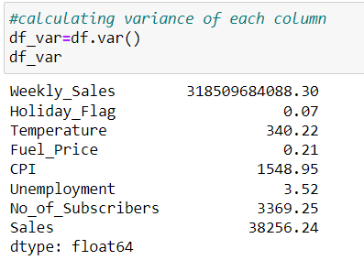
MOM

Slide 8
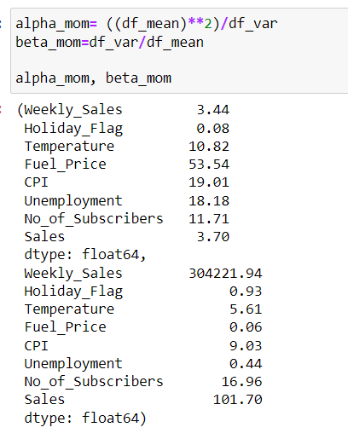

Slide 9
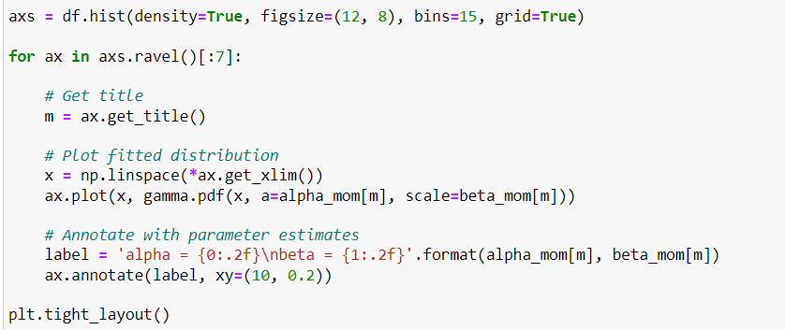

Slide 10
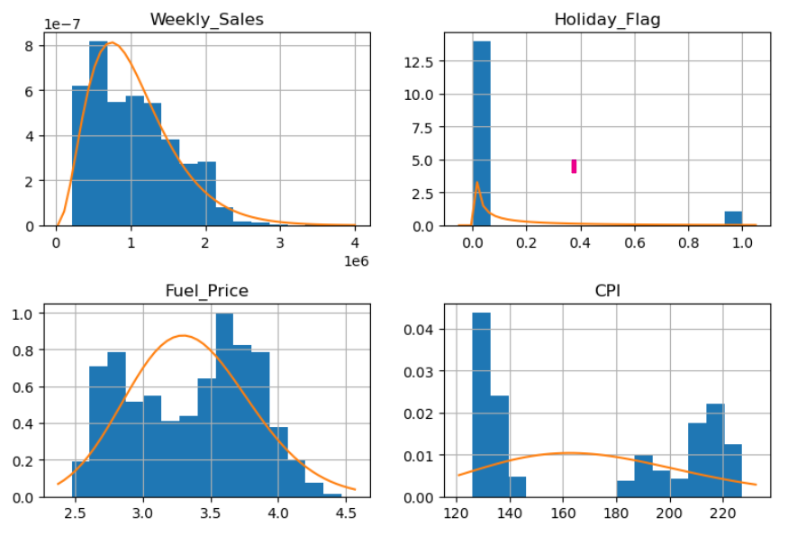
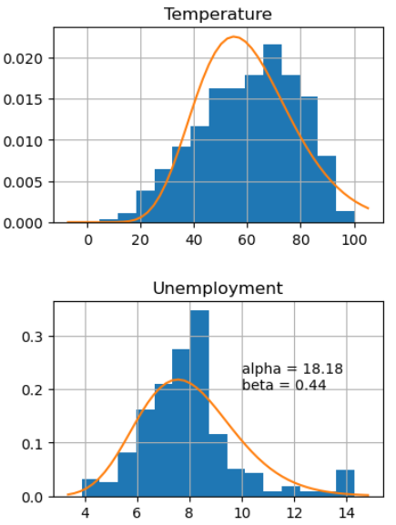
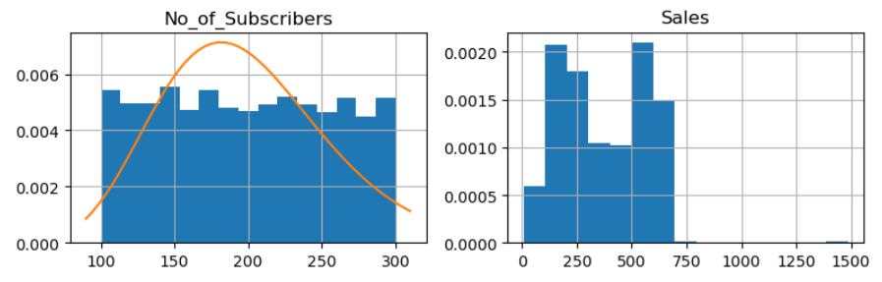

Slide 11
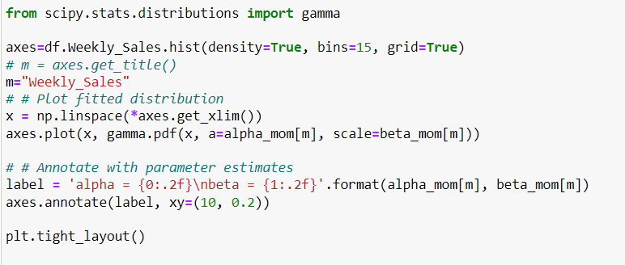
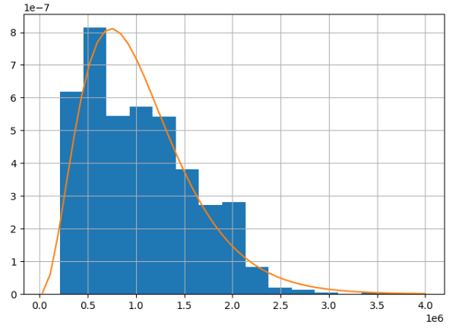

Slide 12
02
Bayesian Regression

Slide 13
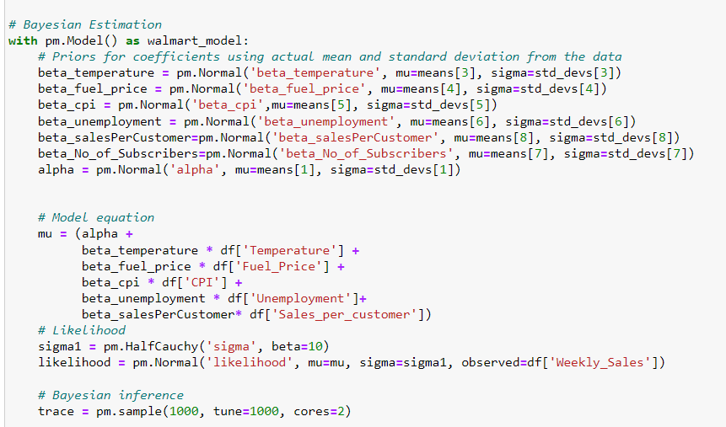
Bayesian Regression DEMO
Model Text Snippet

Slide 14
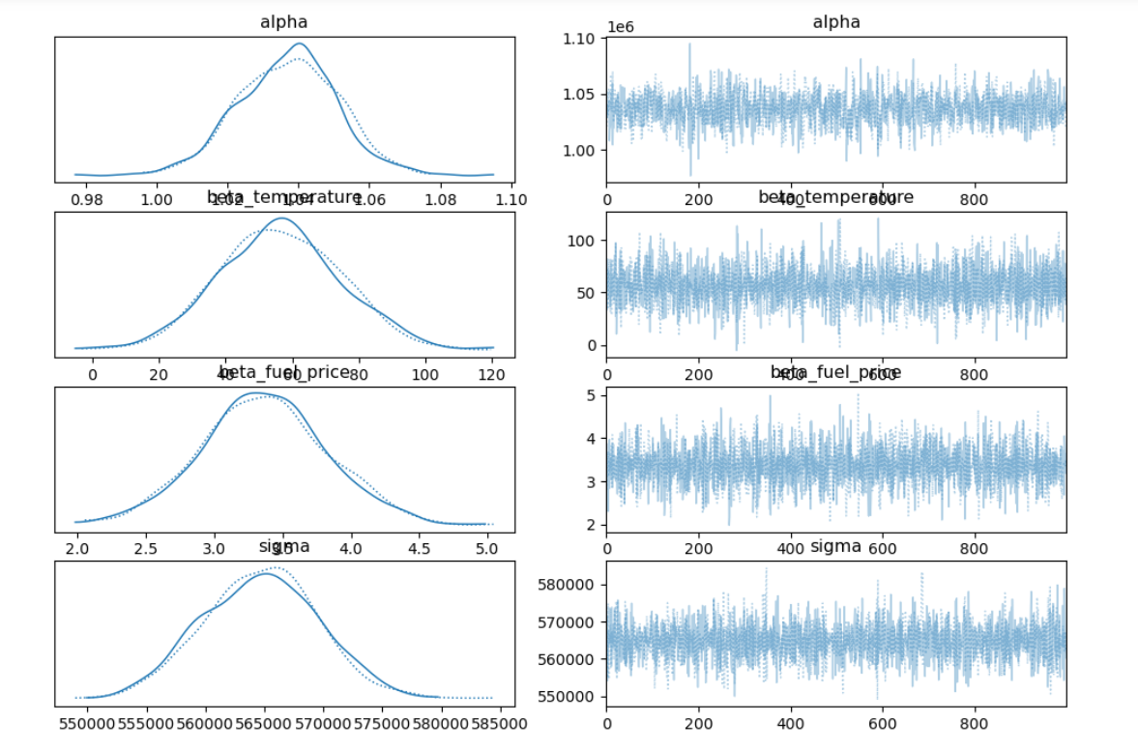

Slide 15
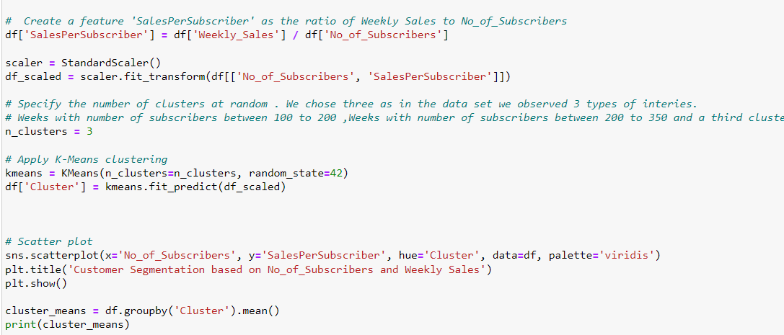
Customer Segmentation for Sales per Cutomer
Code snippet for customer Segmentation

Slide 16
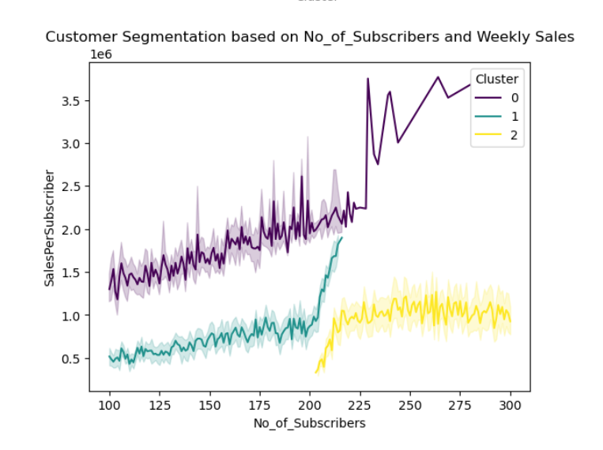

Slide 17
Conclusion
The insights gained from the analysis of weekly sales of walmart using statistical methods such as the method of moments and Bayesian regression can be leveraged for strategic decision-making and improving business performance.

